Slide 1

Contract Monthly Claim System (CMCS)
Automation and Enhancement for Seamless Claim Management
Presented by: Mpho Glan Malinga

Slide 2
Introduction
Objective: To automate and enhance the CMCS for lecturers, coordinators, and HR personnel, improving efficiency and accuracy.
Key Features:
1. Simplified claim submission for lecturers.
2. Automated verification for coordinators and managers.
3. Efficient claim processing and reporting for HR.
Technologies Used: ASP.NET Core MVC, Entity Framework, Razor Pages, JavaScript (jQuery), SQL Server.

Slide 3
Lecturer Module
Features:
1. Submit hours worked and hourly rates.
2. Auto-calculation of payments.
3. Validation checks for accurate data entry.
Benefits:
- Simplified process.
- Error reduction.

Slide 4
Coordinator and Academic Manager Module
Features:
1. View and verify claims automatically against predefined criteria.
2. Approve or reject claims via a streamlined workflow.
3. Automated status updates for transparency.
Benefits:
- Faster claim processing.
- Improved accuracy in verification.

Slide 5
HR Module
Features:
1. Automated claim processing.
2. Lecturer data management (e.g., updating contact details).
3. Automatic invoice and report generation.
Benefits:
- Streamlined administrative tasks.
- Enhanced data accuracy.

Slide 6
Automation Features
Implemented Automation:
1. Auto-calculation of payments.
2. Validation for claim submissions.
3. Workflow automation for approvals.
4. Invoice generation for approved claims.
Tools Used:
- Razor Pages for UI.
- FluentValidation for data checks.
- SQL Server Reporting Services (SSRS) for reports.

Slide 7

Technology Stack
Front-End: ASP.NET Core MVC, Razor Pages, Bootstrap, jQuery.
Back-End: C#, Entity Framework Core, ASP.NET Web API.
Database: SQL Server.
Authentication: ASP.NET Identity.
Version Control: GitHub.

Slide 8

Key Benefits
For Lecturers:
- Ease of use with automated calculations.
- Transparency in claim status.
For Coordinators/Managers:
- Faster approval processes.
- Reduced manual errors.
For HR:
- Streamlined report generation.
- Efficient data management.

Slide 9
System Workflow
Process Flow:
1. Lecturer submits a claim.
2. Coordinator verifies and approves/rejects.
3. HR processes approved claims and generates invoices.

Slide 10

Feedback and Improvements
Feedback:
- Use MVC architecture.
- Include sample data in screenshots.
Implemented Changes:
1. Migrated to MVC architecture.
2. Added sample data in screenshots.
3. Enhanced automation features.

Slide 11
GitHub Version Control
Repository Overview:
- Link to the repository.
- Total commits: 10+ with descriptive messages.
Example Commit Messages:
1. 'Added Lecturer auto-calculation feature.'
2. 'Implemented FluentValidation for claim submissions.'

Slide 12
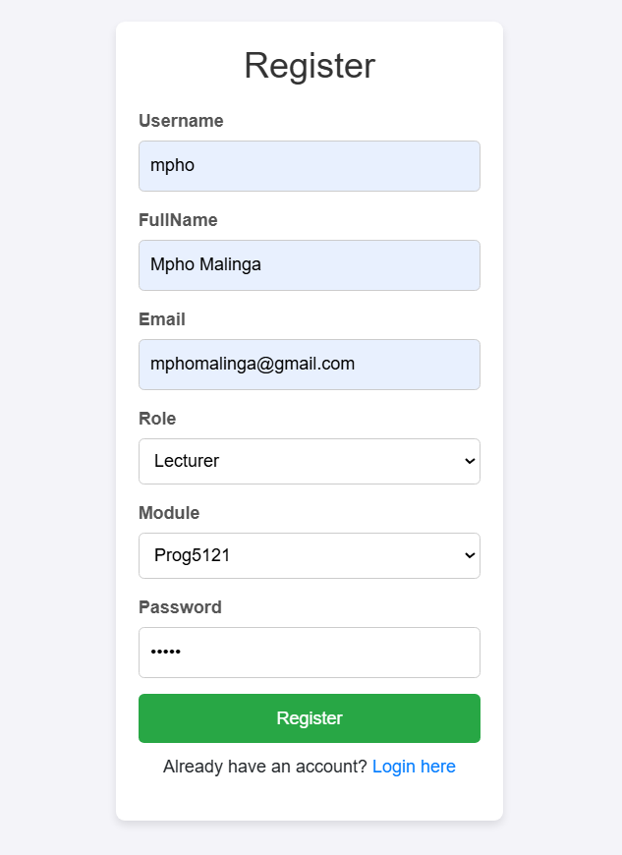
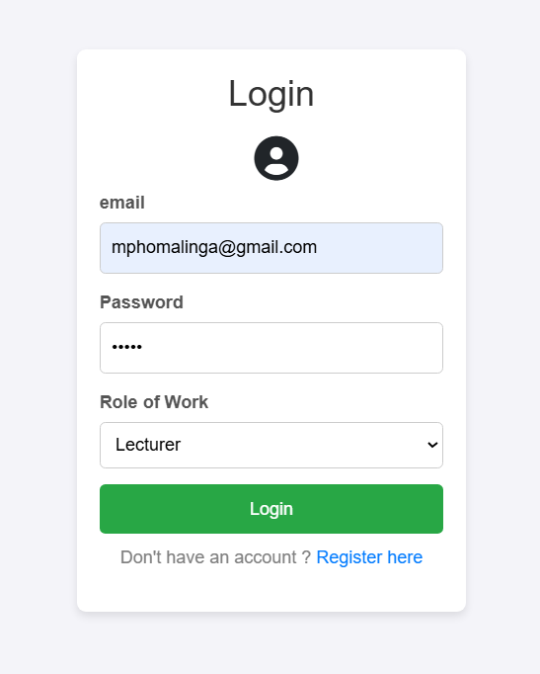
Screenshots for Application

Slide 13
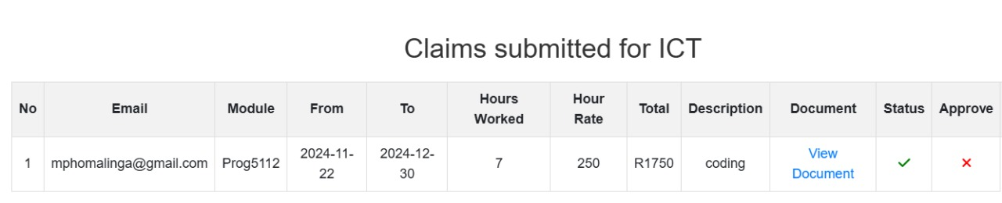
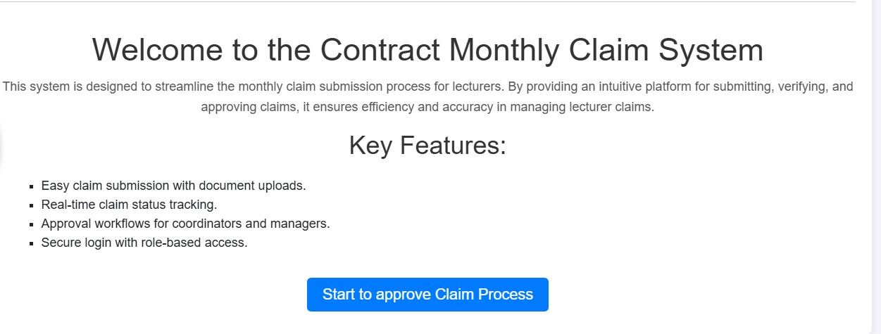
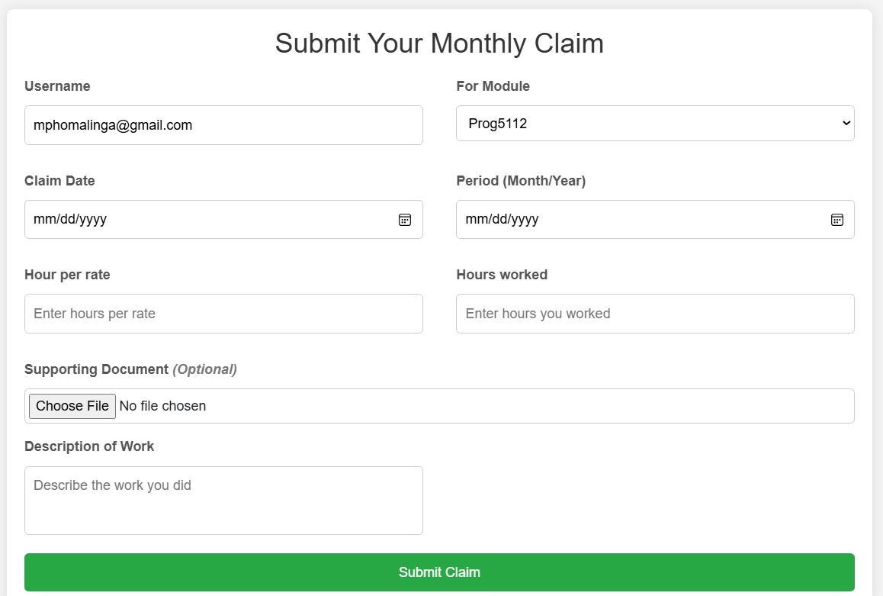
Screenshots for Application

Slide 14
Conclusion
Summary:
- The CMCS improves claim processing efficiency.
- Automation reduces errors and enhances user experience.
- Ready for deployment in academic environments.
Next Steps:
1. Deployment to a live server.
2. User training and feedback collection.

